Slide 1
Sector Name
TCIC

Slide 2
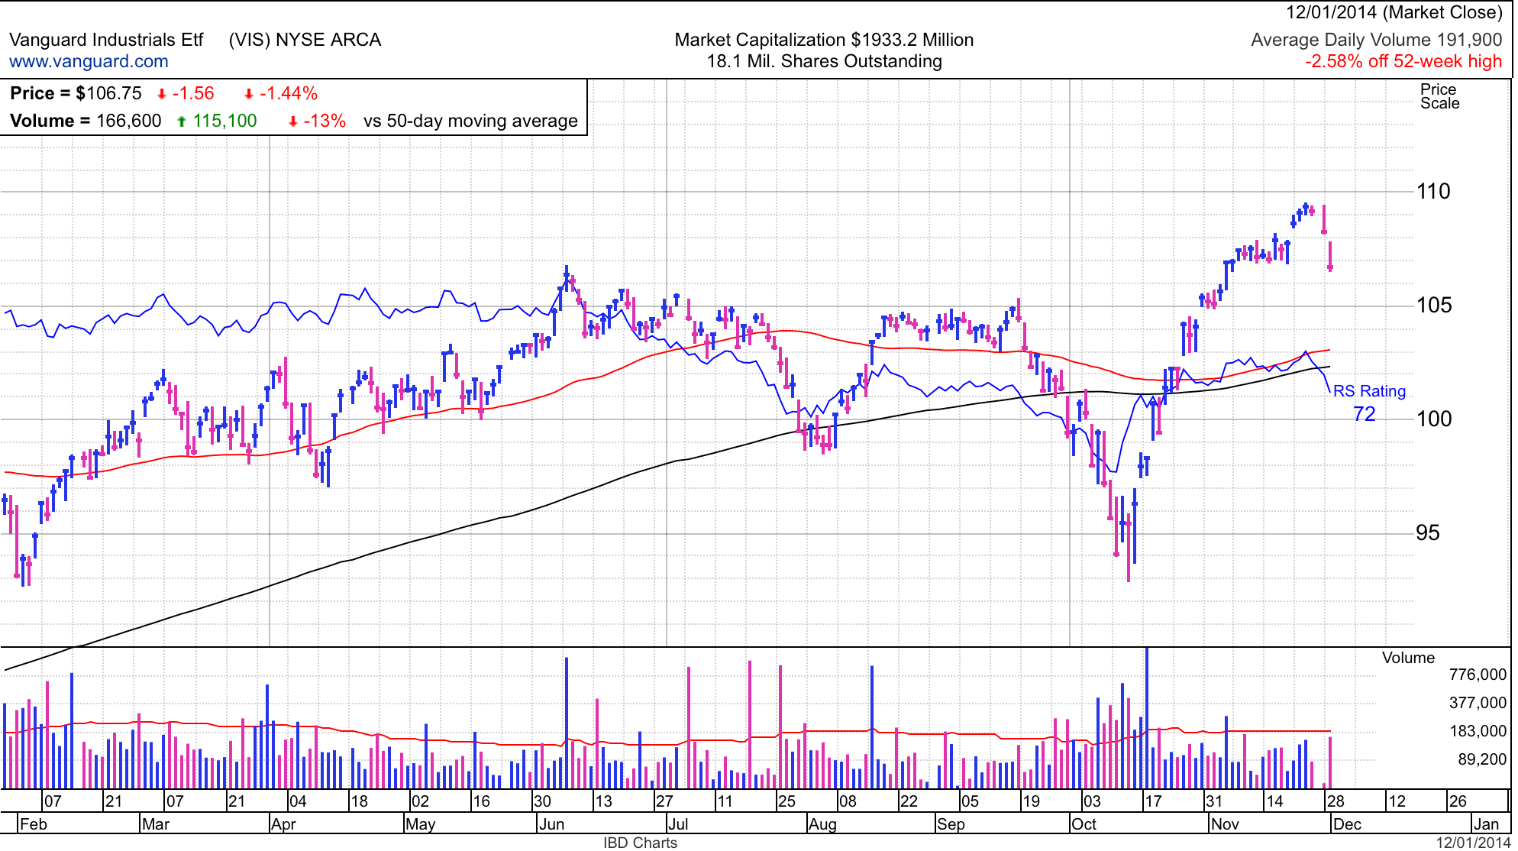
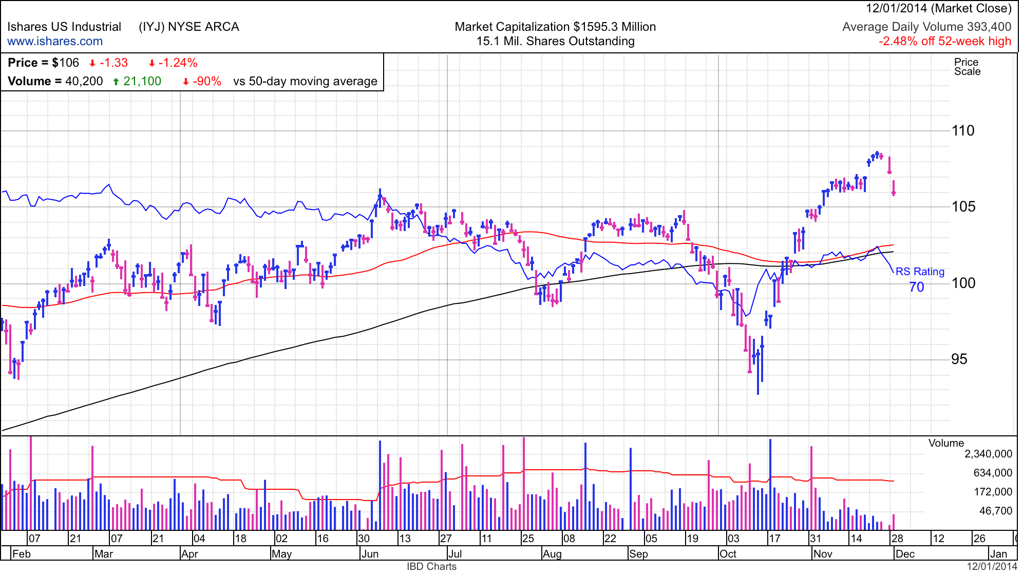
Sector Overview (past week)

Slide 3
Holdings
List of holdings

Slide 4
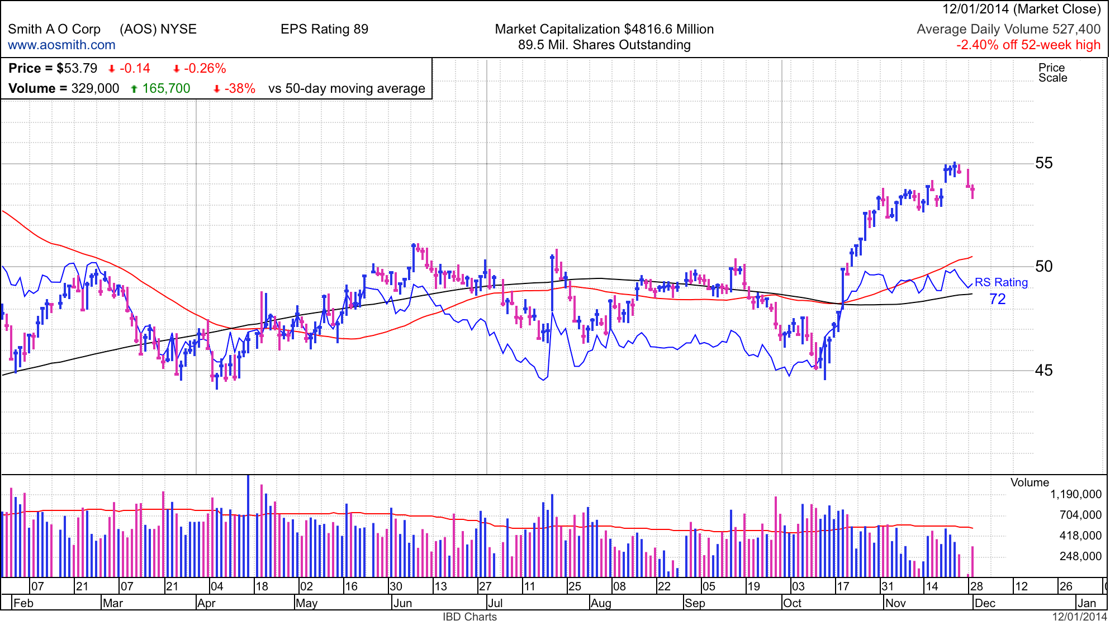
Chart of Holding #1 (Full Screen)

Slide 5
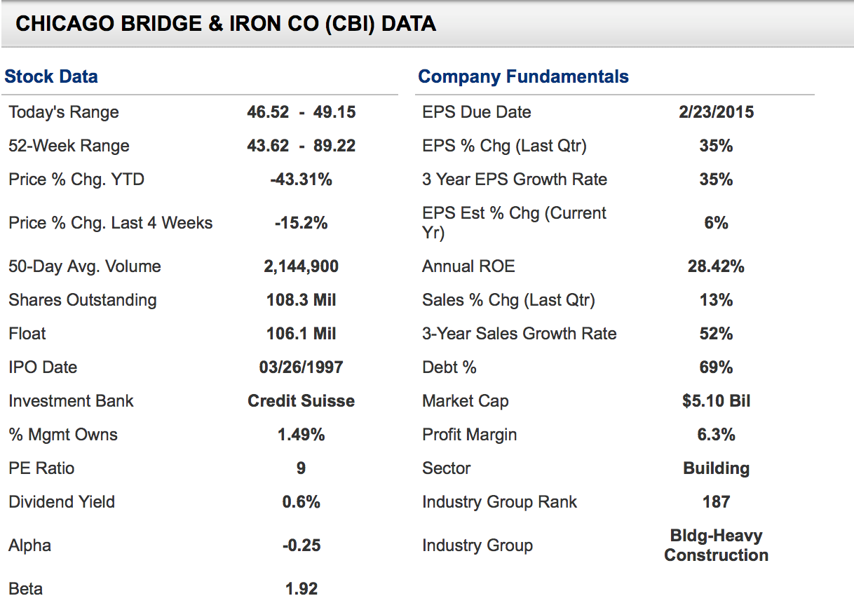
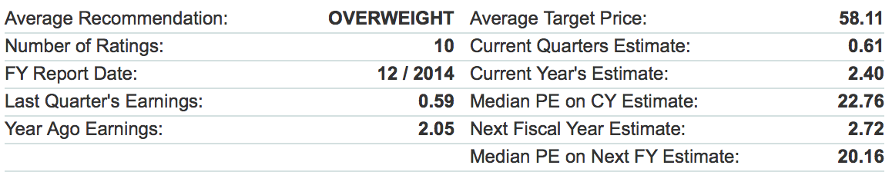
Holding #1
Smith A O Corp (AOS) - MANUFACTURES WATER HEATING EQUIPMENT FOR VARIOUS RESIDENTIAL AND COMMERCIAL MARKETS WORLDWIDE.
Brief Description of holding
Below Here:::::: List Fundamental indicators. 52 wk range, quarterly EPS % increase,
Pros- List all of the good aspects of your position.
Cons- List all the bad aspects of your position.
Below, we have some analyst opinions of the holding

Slide 6
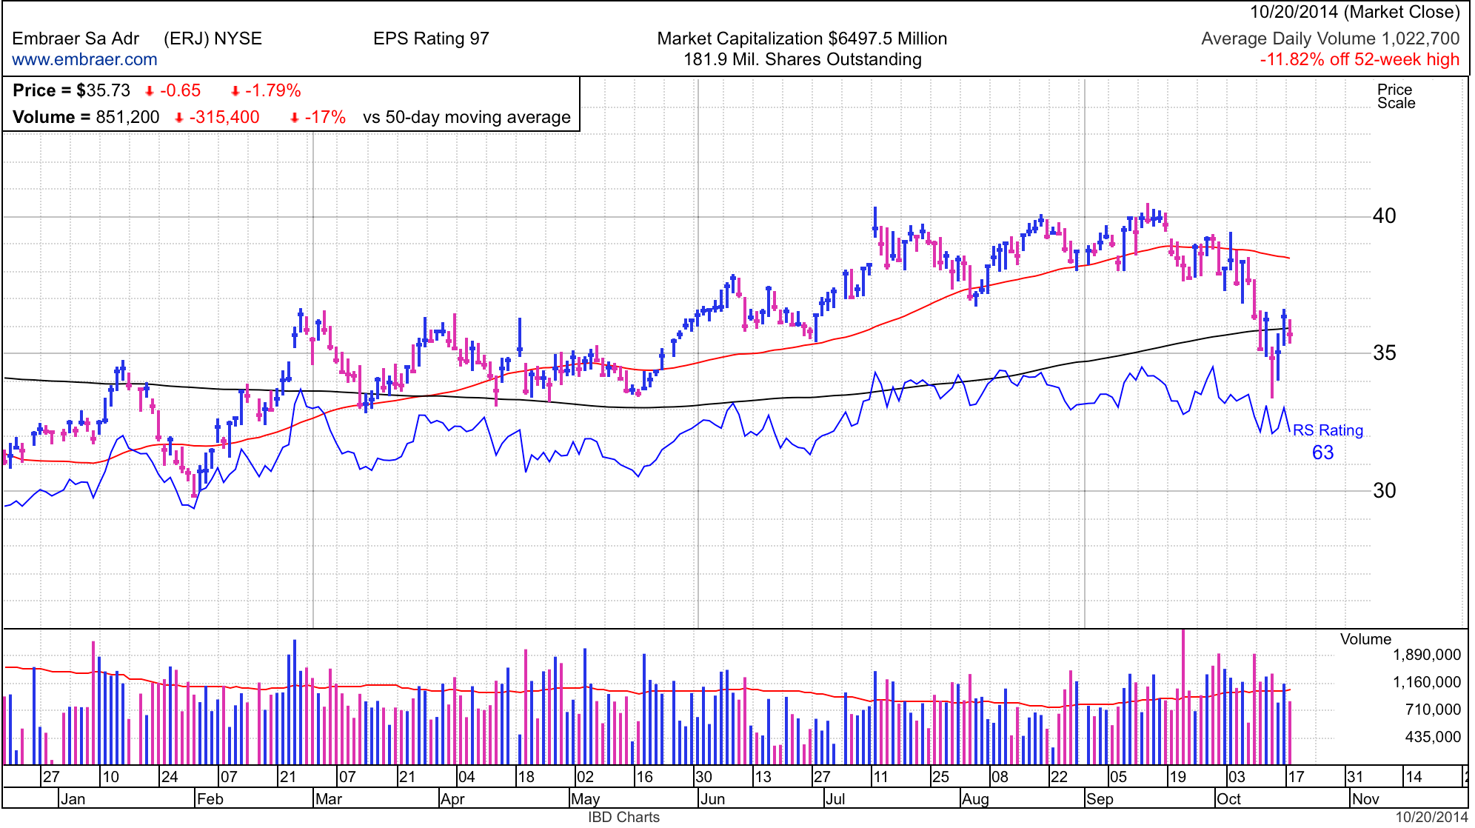
Buy recommendation: Embraer Sa Adr (ERJ)

Slide 7
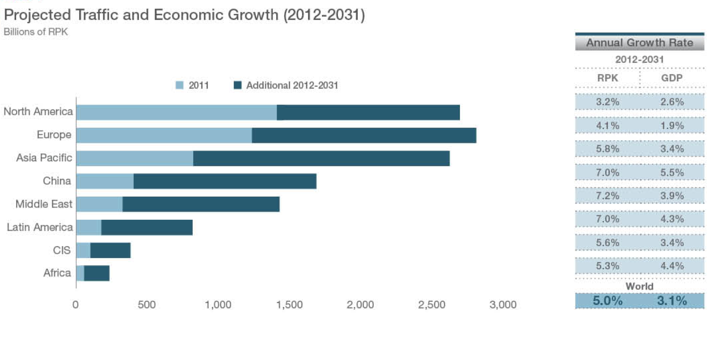
Buy recommendation: Embraer Sa Adr (ERJ)

Slide 8
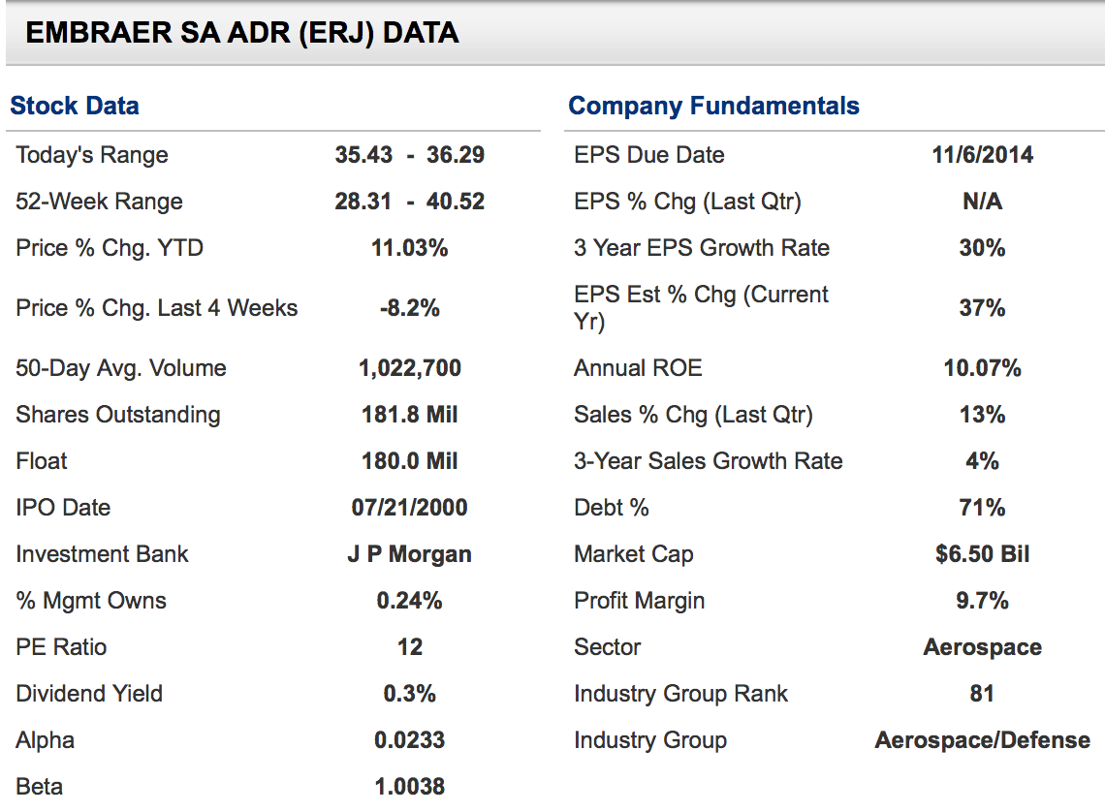
Buy recommendation: Embraer Sa Adr (ERJ)

Slide 9
